Slide 1
Non-Parametric Models
Tech Frontiers
David Quigley

Slide 2
Machine Decision Making - 101
Think back to your very first days of programming…
I ask you to have a program take in two pieces of information:
- sun
- wind
And output whether or not I am going to play tennis.
- Only if it’s sunny and not too windy
What does this program look like?

Slide 3
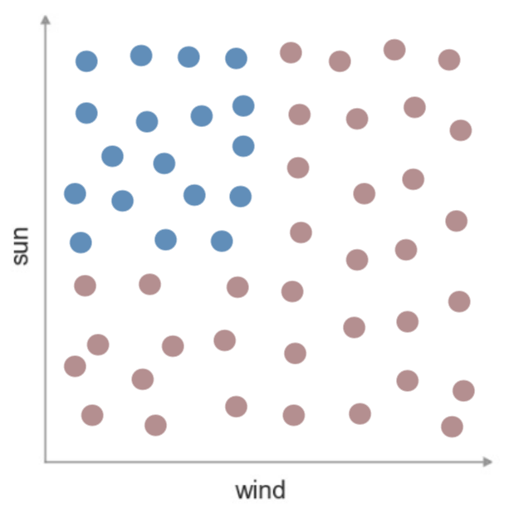
Machine Decision Making - Tennis
Consider this visualization of my data
And our model of a predictor
What would the decision boundary look
like here?

Slide 4
Machine Decision Making - 201
Think back to your very second days of
programming (i.e. data structures)…
How might we represent a series of
nested if/else statements?

Slide 5
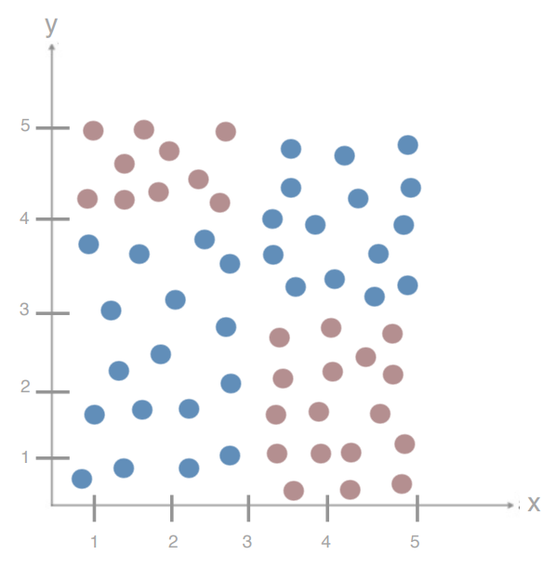
Decision Trees – Adding Complexity
What is my Decision Tree for this dataset?

Slide 6
Decision Trees – Adding Complexity
What happens if I split on Y first?

Slide 7
Decision Trees – Adding Complexity
How do we decide the order of our splits?
How do we decide the location of splits?
With continuous variables?
How do we know we’re done?

Slide 8
Decision Trees - Entropy
A measure of the impurity / messiness / chaos of a set of examples

Slide 9
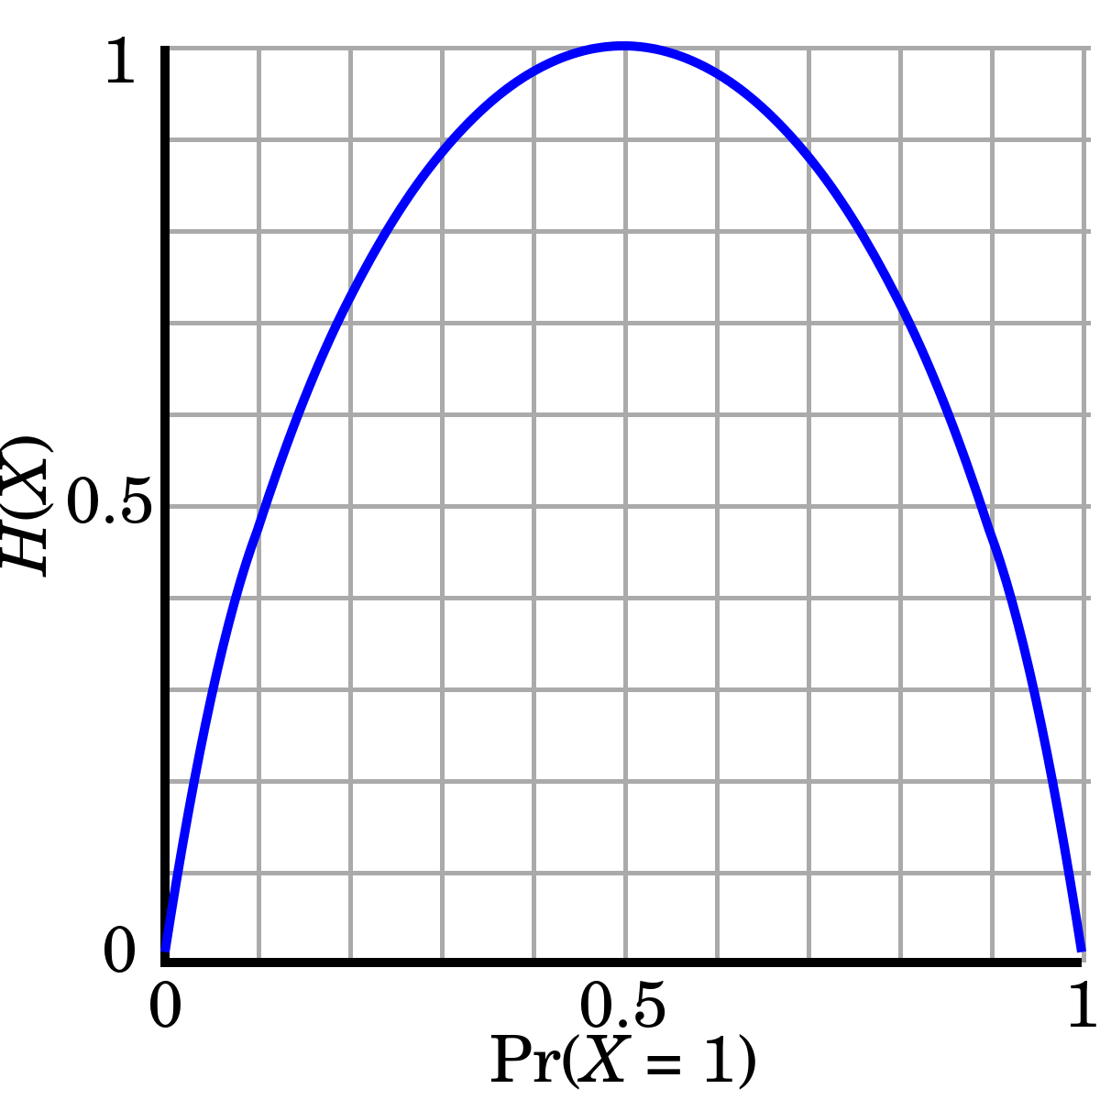
Decision Trees - Entropy
A measure of the impurity / messiness / chaos of a set of examples
Entropy = ∑_{c=1…n} [-p_{c} * log₂(p_{c})]
C for each possible class
In the binary case…
Entropy = -p * log₂(p) – (1-p) * log₂(1-p)
What happens at p = 1? p = 0? p = 0.5?
Minimum – perfect isolation of one class, Entropy = 0
Maximum – perfect split of data, Entropy = 1

Slide 10
Decision Trees - Entropy
A measure of the impurity / messiness / chaos of a set of examples
Entropy = ∑_{c=1…n} [-p_{c} * log₂(p_{c})]
C for each possible class
In the general case… (3 class case)
P_{c} = .33 for all c P = {1,0,0}
Entropy is maximized (~ 1.56) Entropy is 0
P₁ = .4 P₂ = .4 P₃ = .2
Entropy is reduced (~1.52)

Slide 11
Decision Trees – Minimizing Entropy
We are creating a split to minimize the entropy of our set…

Slide 12
Decision Trees – Minimizing Entropy
We are creating a split to minimize the entropy of our set…
But really, we’re creating two sets, each with their own entropy, but a smaller number of samples in each.
entropy = 1
entropy = 0

Slide 13
Decision Trees – Minimizing Entropy
We are creating a split to minimize the entropy of our set…
But really, we’re creating two sets, each with their own entropy, but a smaller number of samples in each.
red = .75(ish)
entropy = 0.8
(or so)
Is it better to split evenly, or finely?
entropy = 0

Slide 14
Decision Trees – Minimizing Entropy
We are creating a split to minimize the entropy of our set…
But really, we’re creating two sets, each with their own entropy, but a smaller number of samples in each.
What makes for a good split?

Slide 15
Decision Trees – Minimizing Entropy
We are creating a split to minimize the entropy of our set…
But really, we’re creating two sets, each with their own entropy, but a smaller number of samples in each.
D_{par} = Data found in Parent Node (left)
D_{left} = Data found in Left Node
D_{right} = Data found in Right Node
I() = Impurity function (entropy) (right)
x_{i} = feature for split

Slide 16
Decision Trees – Information Gain
D_{par} = Data found in Parent Node
D_{left} = Data found in Left Node
D_{right} = Data found in Right Node
I() = Impurity function (entropy)
x_{i} = feature for split
$$IG\left(Dpar,xi\right)=(I\left(Dpar\right)−\frac{\left|\left(Dleft\right)\right|}{|\left(Dpar\right)|} ∗I(Dleft)−\frac{\left|\left(Dright\right)\right|}{|\left(Dpar\right)|} ∗I(Dright)$$

Slide 17
Decision Trees – Choosing a Split
$$IG\left(Dpar,xi\right)=I\left(Dpar\right)−\frac{\left|\left(Dleft\right)\right|}{\left|\left(Dpar\right)\right|} ∗I(Dleft)−\frac{\left|\left(Dright\right)\right|}{\left|\left(Dpar\right)\right|} ∗I(Dright)$$
Split based on the feature x_{i} with the highest Information Gain!

Slide 18
Decision Trees – Measures of Impurity
We used Entropy as the measure of impurity / messiness / chaos
Is this the only option? The correct option?

Slide 19
Decision Trees – Measures of Impurity
We used Entropy as the measure of impurity / messiness / chaos
Is this the only option? The correct option?
Is it sunny in Yuma, AZ? 87% yes

Slide 20
Decision Trees – Measures of Impurity
We used Entropy as the measure of impurity / messiness / chaos
Is this the only option? The correct option?
Is it sunny in Yuma, AZ? 87% yes
Misclassification Error = min(p, 1-p) = 13%

Slide 21
Decision Trees – Measures of Impurity
We used Entropy as the measure of impurity / messiness / chaos
Is this the only option? The correct option?
Gini Index: 1 - ∑_{c=1…n} p_{c}²
Binary case: 1 – p² – (1 – p)² = 2p(p-1)

Slide 22
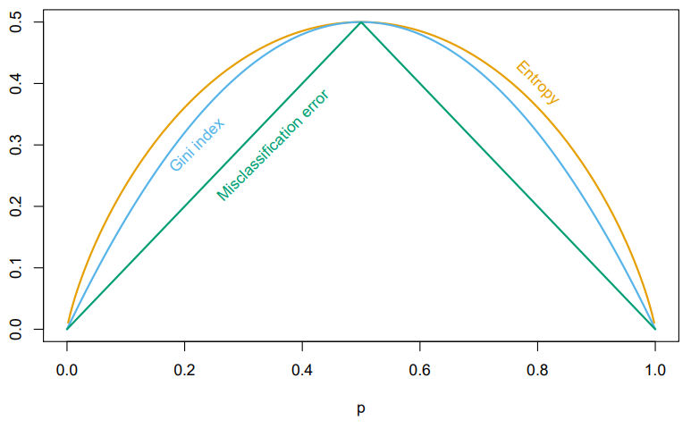
Decision Trees – Measures of Impurity
We used Entropy as the measure of impurity / messiness / chaos
Is this the only option? The correct option?
Considerations: Differentiability, Computational Speed
Different implementations (CART, C4.5) use different functions

Slide 23
Decision Trees – Adding Complexity
How do we decide the order of our splits?
How do we decide the location of splits?
With continuous variables?
How do we know we’re done?

Slide 24
Decision Trees – Stopping Point
Creating Leaves

Slide 25
Decision Trees – Stopping Point
Creating Leaves
When we reach 0 entropy

Slide 26
Decision Trees – Stopping Point
Creating Leaves
When we reach 0 entropy

Slide 27
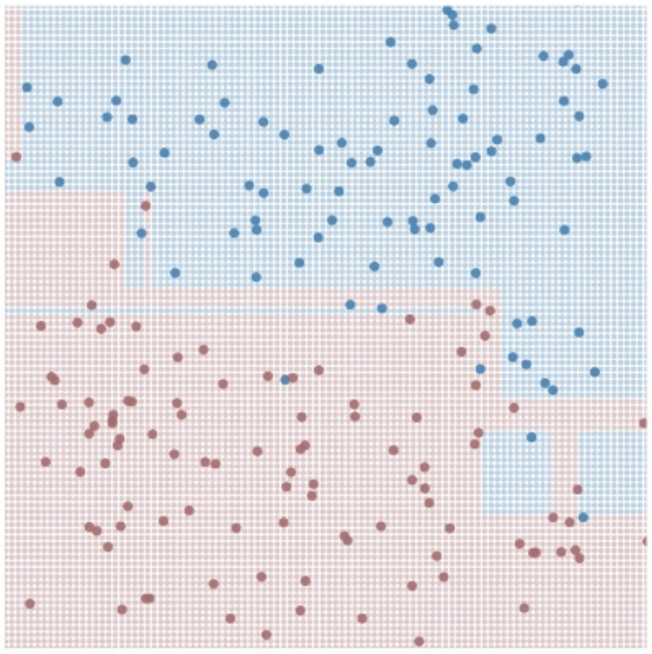
Decision Trees – Stopping Point
Large, Complex Trees

Slide 28
Interlude - Overfitting

Slide 29
Overfitting your model
Remember the idea that we’re only training (i.e. building our model itself) on a subset of our data.
What happens if we build a really complex tree?
Train Data
Test Data

Slide 30
Decision Trees – Stopping Point
Large, Complex Trees
# dimensions spirals out of control
Prone to high variance
Overfitting

Slide 31
Decision Trees – Stopping Point
Large, Complex Trees
# dimensions spirals out of control
Prone to high variance
Overfitting
What do you want to do about it?

Slide 32
Decision Trees – Limiting Complexity
Set a maximum depth for your tree

Slide 33
Underfitting your model
Remember the idea that we’re only training (i.e. building our model itself) on a subset of our data.
What happens if we build an overly simple tree?
Train Data
Test Data

Slide 34
Decision Trees – Limiting Complexity
Set a maximum depth for your tree
But not too shallow. This will depend tree to tree.
Set a maximum number of leaves for your tree (proxy on depth, but allows for deep and shallow branches)

Slide 35
Decision Trees – Limiting Complexity
Set a maximum depth for your tree
Set a maximum number of leaves for your tree (proxy on depth, but allows for deep and shallow branches)
Penalize larger trees (more leaves)

Slide 36

Decision Trees – Pruning
Remove segments (subtrees from your tree)
Notes:
https://yourwaytreeserviceinc.com/wp-content/uploads/2014/04/tree-trimming-san-fernando-valley.jpg

Slide 37
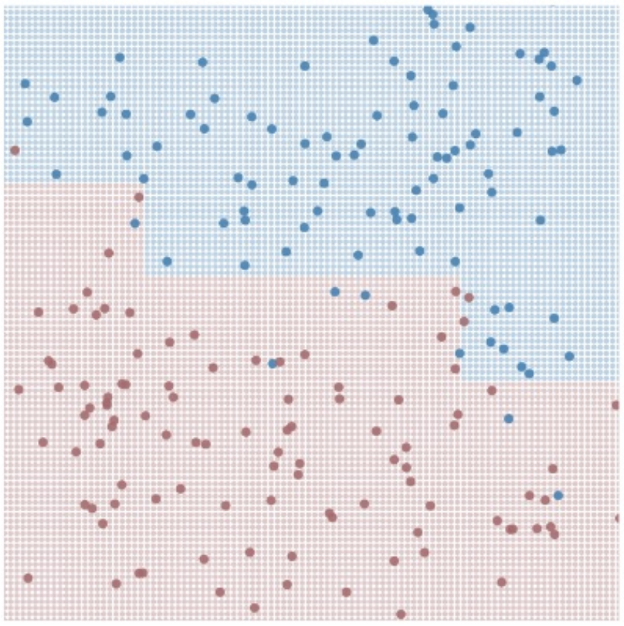
Decision Trees – Pruning
Remove segments (subtrees from your tree)
→

Slide 38
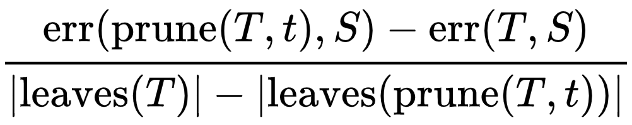
Decision Trees – Limiting Complexity
Penalize larger trees (more leaves)
https://en.wikipedia.org/wiki/Decision_tree_pruning

Slide 39
Ensemble Methods, Boosting, Bagging, & Random Forests

Slide 40
Intuition
Let’s build a few “bad” models

Slide 41
Intuition
Let’s build a few “bad” models
Let’s then combine the predictions!

Slide 42
Intuition
Let’s build a few “bad” models
Let’s then combine the predictions!
Let’s add even more “bad” models!

Slide 43
Ensemble Methods
Build a bunch of dumb models on the training data
There are a bunch of ways to do this, stay tuned!
Feed our test data to all the models, get predictions
Take the best class from all of these models as our answer

Slide 44
Ensemble Learning – Dataset
X₁ | X₂ | X₃ | X₄ | X₅ | Y
Size (Sq. Ft.) | # Bed | # Bath | Year Built | Price ($) | Single Family?
1200 | 1 | 1.5 | 1998 | 200,000 | No
1800 | 2 | 2 | 1985 | 450,000 | Yes
800 | 1 | 1 | 2017 | 250,000 | No
2500 | 3 | 2 | 1975 | 500,000 | No
2800 | 4 | 2.5 | 1983 | 400,000 | Yes
… | … | … | … | …

Slide 45
Building “Dumb” Models – Step 1
Maybe 10% of the points in training
are causing errors with testing…

Slide 46
Building “Dumb” Models – Step 1
Maybe 10% of the points in training
are causing errors with testing…

Slide 47
Building “Dumb” Models – Step 1
Maybe 10% of the points in training
are causing errors with testing…
What happens if I build a tree based on
a resampling of my points?

Slide 48
Building “Dumb” Models – Resampling
Pick N’ (number in subsample) points
Train model on subsample

Slide 49
Building “Dumb” Models – Resampling
Pick N’ points
Train model on subsample

Slide 50
Building “Dumb” Models – Step 1
Maybe 10% of the points in training
are causing errors with testing…
What happens if I build a tree based on
10% of the points?

Slide 51
Building “Dumb” Models – Step 1
Maybe 10% of the points in training
are causing errors with testing…
What happens if I build a tree based on
10% of the points?
What happens if I build a tree based on
90% of the points?

Slide 52
Building “Dumb” Models – Resampling
Small Subsets
- Prone to high bias (underfitting)

Slide 53
Building “Dumb” Models – Resampling
Small Subsets
- Prone to high bias (underfitting)
Large Subsets
- Prone to behave exactly like our dataset

Slide 54
Building “Dumb” Models – Bootstrapping
Large Subsets with replacement
- We will oversample some points, neglect others

Slide 55
Building “Dumb” Models – Bootstrapping
Large Subsets with replacement
- We will oversample some points, neglect others
Sampling N’ = N
- Expected 1 – 1/e (approx. 63.2%) coverage
https://en.wikipedia.org/wiki/Bootstrap_aggregating

Slide 56
Building “Dumb” Models – Bootstrapping
Large Subsets with replacement
- We will oversample some points, neglect others
Sampling N’ = N
- Expected 1 – 1/e (approx. 63.2%) coverage
N is too large for my memory
- Reduce N’ – but realize the bias-variance tradeoff
https://en.wikipedia.org/wiki/Bootstrap_aggregating

Slide 57
Building “Dumb” Models – Step 2
Maybe 10% of the points in training
are causing errors with testing…
What happens if I build a tree based on a resampling of the points?

Slide 58
Building “Dumb” Models – Step 2
Maybe 10% of the points in training
are causing errors with testing…
What happens if I build a tree based on a resampling of the points?
What happens if I build a bunch of trees based on a resampling of the points?

Slide 59
Building “Dumb” Models – Bagging (Bootstrap Aggregating
TRAINING
For M (# Models) iterations:
Select N points with replacement
Train a decision tree
Hang on to that decision tree
TESTING
For each test point:
Ask all the decision trees what decision to make
Accept Y (the best answer)

Slide 60
Building “Dumb” Models – Bagging
TRAINING
For M iterations:
Select N points with replacement
Train a decision tree
Hang on to that decision tree
TESTING
For each test point:
Ask all the decision trees what decision to make
Accept Y

Slide 61
Ensemble Learning
Build a group of models H(x) = h₁(x), h₂(x), … h_{k}(x)

Slide 62
Building “Dumb” Models – Bagging
TRAINING
For K iterations:
Select N points with replacement
Train a decision tree
Hang on to that decision tree
TESTING
For each test point:
Ask all the decision trees what decision to make
Accept Y

Slide 63
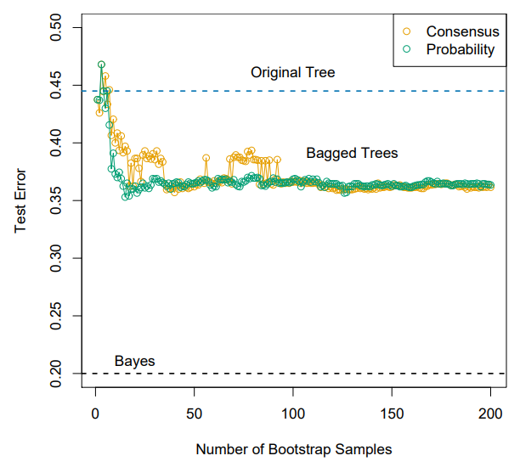
Bagging – Appropriate number of models
In short – it depends
- Think of this as a stopping parameter, or something you can tune in your design
- You’ll see numbers like 30, 50, 100 used a lot…

Slide 64
Bagging – Choosing Consensus
Binary decision from each tree
Take the majority decision

Slide 65
Ensemble Learning – Example (walkthrough)
X₁ | X₂ | X₃ | X₄ | X₅ | Y
Size (Sq. Ft.) | # Bed | # Bath | Year Built | Price ($) | Single Family?
1200 | 1 | 1.5 | 1998 | 200,000 | No
1800 | 2 | 2 | 1985 | 450,000 | Yes
800 | 1 | 1 | 2017 | 250,000 | No
2500 | 3 | 2 | 1975 | 500,000 | No
2800 | 4 | 2.5 | 1983 | 400,000 | Yes
… | … | … | … | …

Slide 66
Ensemble Learning
Build a group of models H(x) = h₁(x), h₂(x), … h_{k}(x)
$$H\left(x\right)=sign(\sum_{k=1}^{K}{hk\left(x\right)})$$

Slide 67
Bagging - Benefits

Slide 68
Bagging - Benefits
Reducing the variance?

Slide 69
Bagging - Benefits
Reducing the variance
Variance – Sensitivity to the training set
Yes

Slide 70
Bagging - Benefits
Reducing the variance
Variance – Sensitivity to the training set
Yes
Reducing the bias?

Slide 71
Bagging - Benefits
Reducing the variance
Variance – Sensitivity to the training set
Yes
Reducing the bias
Bias – Sensitivity to the model
No

Slide 72
Ensemble Learning - Improvements
We have aggregated models helping reduce the variance, but how can we reduce the bias?
Bias – Sensitivity to the model

Slide 73
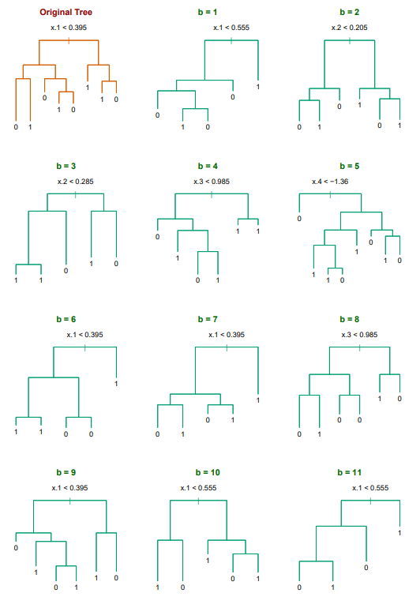
Ensemble Learning - Improvements
We have aggregated models helping reduce the variance, but how can we reduce the bias?
Bias – Sensitivity to the model
Looking at some example trees…

Slide 74
Ensemble Learning – Reducing Bias
The trees are demonstrating high correlation
- Many of our trees are using an identical splitting point for the first decision!
- This correlation is a source of bias
We need to force the trees to care about different features

Slide 75
Ensemble Learning – Feature Subsets
Within the bagging loop, force each split to be made based on a subset of features
X₁ | X₂ | X₃ | X₄ | X₅ | Y
Size (Sq. Ft.) | # Bed | # Bath | Year Built | Price ($) | Single Family?
1200 | 1 | 1.5 | 1998 | 200,000 | No
1800 | 2 | 2 | 1985 | 450,000 | Yes
800 | 1 | 1 | 2017 | 250,000 | No
2500 | 3 | 2 | 1975 | 500,000 | No
2800 | 4 | 2.5 | 1983 | 400,000 | Yes
… | … | … | … | …

Slide 76
Ensemble Methods– Random Forests
TRAINING
For M iterations:
Select N’ points with replacement
Train a decision tree:
For each split:
Choose F features to split on:
Choose your best split from them
Hang on to that decision tree
TESTING
For each test point:
Ask all the decision trees what decision to make
Accept Y

Slide 77
Random Forests – Choosing # Features (F)
In short – it depends!
- Treat this as a tuning parameter
- Similar to K in KNN
Sqrt(|X|) is a good
default
X₁ | X₂ | X₃ | X₄ | X₅ | Y
Size (Sq. Ft.) | # Bed | # Bath | Year Built | Price ($) | Single Family?
1200 | 1 | 1.5 | 1998 | 200,000 | No
1800 | 2 | 2 | 1985 | 450,000 | Yes
800 | 1 | 1 | 2017 | 250,000 | No
2500 | 3 | 2 | 1975 | 500,000 | No
2800 | 4 | 2.5 | 1983 | 400,000 | Yes
… | … | … | … | …

Slide 78
Ensemble Methods
We’re building all of these ideas on “Dumb” models, but surely we can do better?
The goodness comes out through aggregation, but some models may be “better” than others
- Can we try to trust these models more?

Slide 79
Boosting

Slide 80
Interlude – A Weak Learner
Assumptions – binary classification problem
both classes are 50% likely
Expectations

Slide 81
Ensemble Methods – A Weak Learner
Assumptions - binary classification problem
both classes are 50% likely
Expectations - A random guess model gets 50% accuracy
$$err=\frac{1}{n}∗∑i1…N I(yi ≠G\left(xi\right))$$

Slide 82
Ensemble Methods – A Weak Learner
Assumptions - binary classification problem
both classes are 50% likely
Expectations - A random guess model gets 50% accuracy
A “weak” learning model would perform slightly better than chance
We can only determine this through training accuracy / error

Slide 83
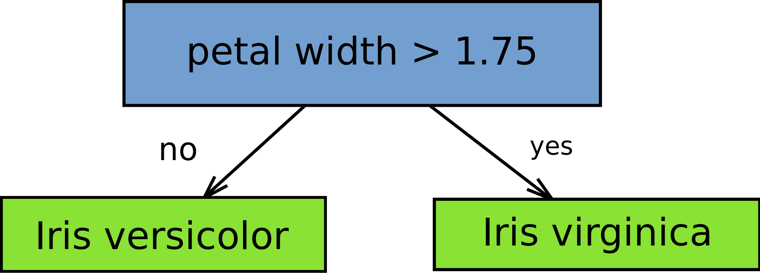
Weak Learner – Decision Stump
A 1-layer decision tree (a.k.a. a decision tree with a single split)
Entropy = -p * log₂(p) – (1-p) * log₂(1-p)
Notes:
https://en.wikipedia.org/wiki/File:Decision_stump.svg

Slide 84
Weak Learner – Decision Stump
A 1-layer decision tree (a.k.a. a decision tree with a single split)
Entropy = -p * log₂(p) – (1-p) * log₂(1-p)
This could serve as a restriction on # dimensions, tree size for random forest!
Notes:
https://en.wikipedia.org/wiki/File:Decision_stump.svg

Slide 85
Ensemble Methods - Boosting
All animals are equal, but some animals are more equal than others.
- George Orwell (Animal Farm, Chapter 10)

Slide 86
Ensemble Methods - Boosting
All animals are equal, but some animals are more equal than others.
- George Orwell (Animal Farm, Chapter 10)
All classifiers are equal, but some classifiers are more equal than others.
In an ensemble classifier, can we favor some of the individual classifiers more than others?

Slide 87
Boosting – Favoring Certain Points
Create a bunch of classifiers
Weight each model k based on how accurate it is
$$H\left(x\right)=sign(\sum_{k=1}^{K}{hk\left(x\right)})$$
becomes
$$H\left(x\right)=sign(\sum_{k=1}^{K}{\text{α}khk\left(x\right)})$$

Slide 88
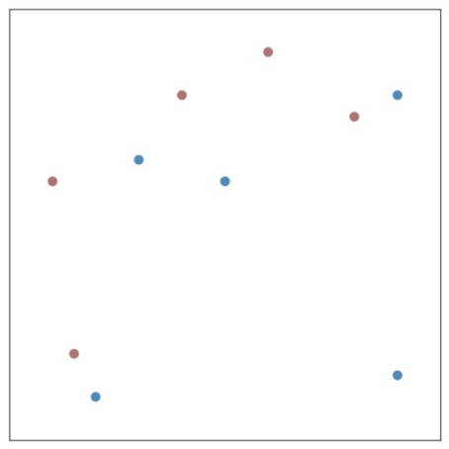
Weights for Individual Classifiers

Slide 89
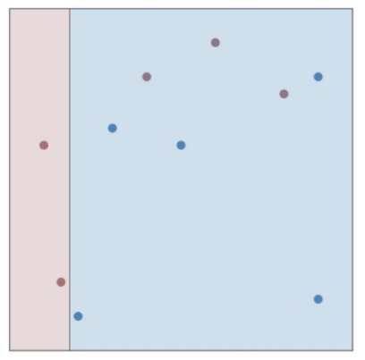
Weights for Individual Classifiers

Slide 90
Weights for Individual Classifiers
$$err= \sum_{i=1}^{m}{I(yi ≠h\left(xi\right))}$$

Slide 91
Weights for Individual Classifiers
$$err= \sum_{i=1}^{m}{I(yi ≠h\left(xi\right))}$$
Err = 3
Error range = [0, ∞]

Slide 92
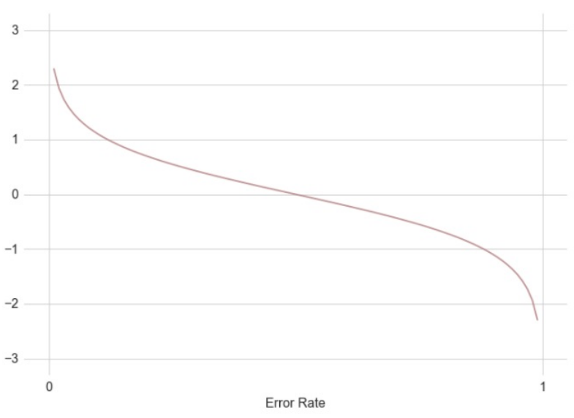
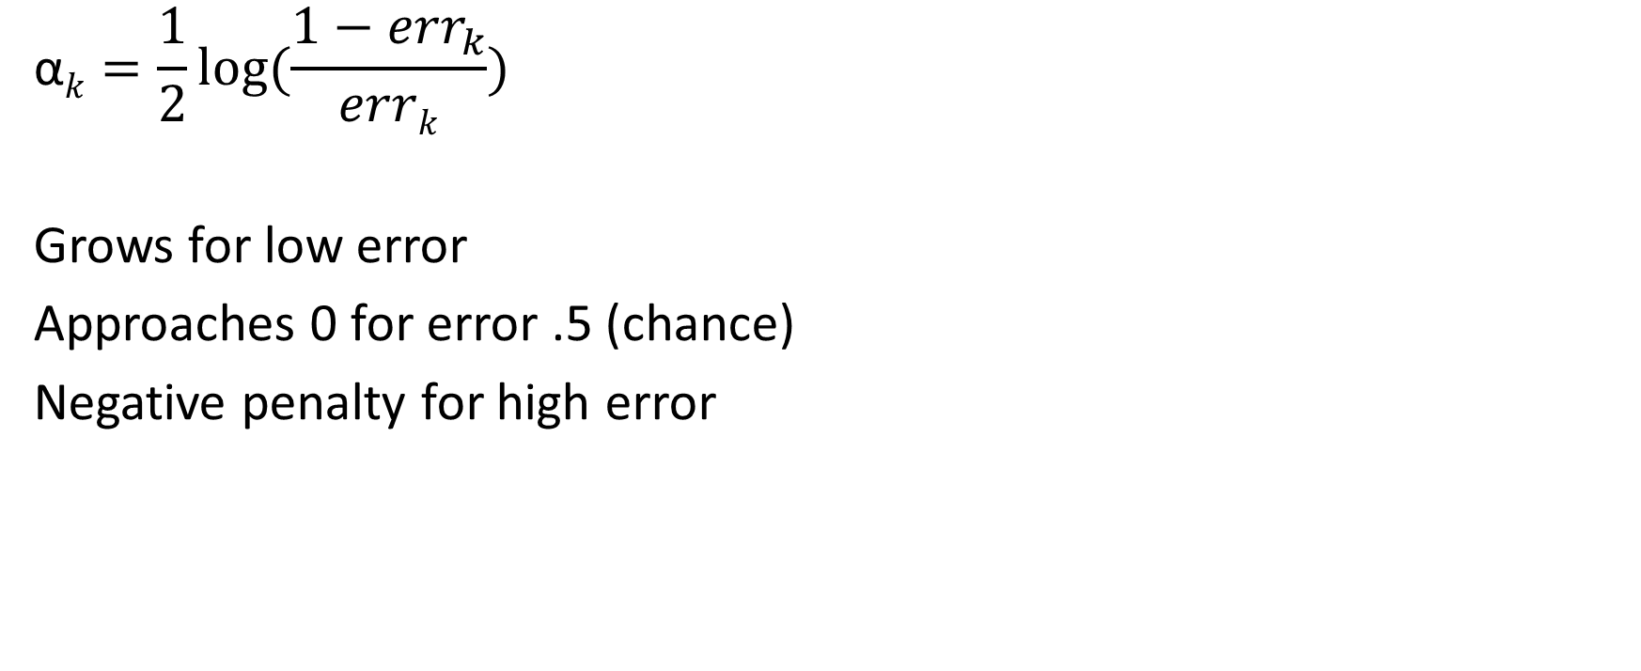
Exponential Weights for Individual Classifiers
$$\text{α}k=\frac{1}{2}log⁡(\frac{1−{err}_{k}}{errk})$$
Grows for low error
Approaches 0 for error .5 (chance)
Negative penalty for high error

Slide 93
Ensemble Methods
We’re building all of these ideas on “Dumb” models, but surely we can do better?
The goodness comes out through aggregation, but some models may be “better” than others
- Can we try to trust these models more?

Slide 94
Boosting

Slide 95
Ensemble Methods - Boosting
All animals are equal, but some animals are more equal than others.
- George Orwell (Animal Farm, Chapter 10)

Slide 96
Ensemble Methods - Boosting
All animals are equal, but some animals are more equal than others.
- George Orwell (Animal Farm, Chapter 10)
All classifiers are equal, but some classifiers are more equal than others.
In an ensemble classifier, can we favor some of the individual classifiers more than others?

Slide 97
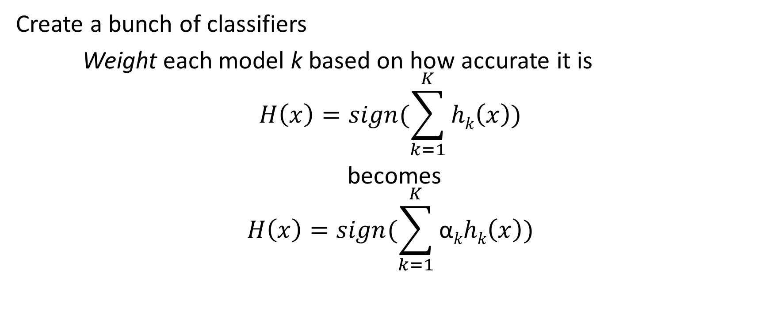
Boosting – Favoring Certain Points
Create a bunch of classifiers
Weight each model k based on how accurate it is
$$H\left(x\right)=sign(\sum_{k=1}^{K}{hk\left(x\right)})$$
becomes
$$H\left(x\right)=sign(\sum_{k=1}^{K}{\text{α}khk\left(x\right)})$$

Slide 98
Weights for Individual Classifiers

Slide 99
Weights for Individual Classifiers

Slide 100
Exponential Weights for Individual Classifiers
$$\text{α}k=\frac{1}{2}log⁡(\frac{1−{err}_{k}}{errk})$$
Grows for low error
Approaches 0 for error .5 (chance)
Negative penalty for high error

Slide 101
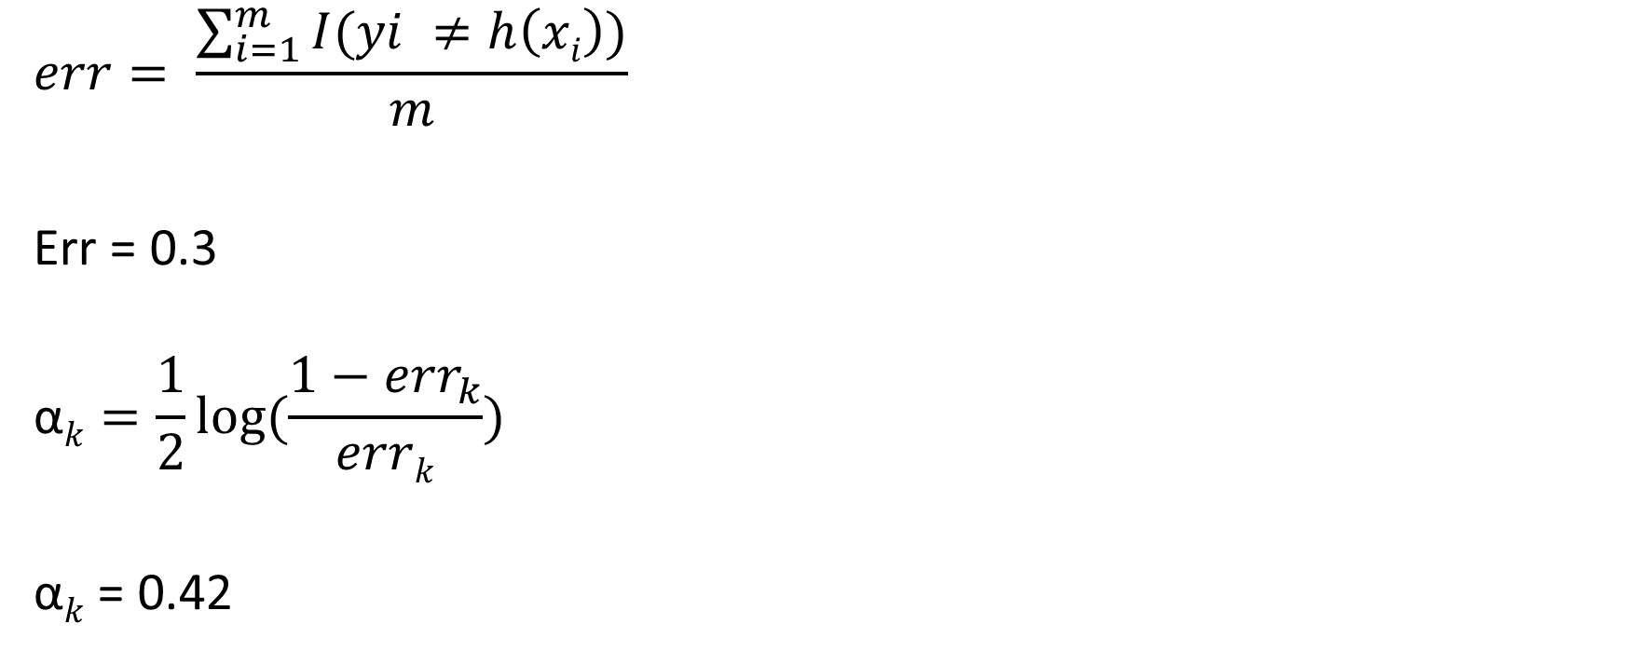
Weights for Individual Classifiers
$$err= \frac{\sum_{i=1}^{m}{I(yi ≠h\left(xi\right))}}{m}$$
Err = 0.3
$$\text{α}k=\frac{1}{2}log⁡(\frac{1−{err}_{k}}{errk})$$
$\text{α}k$ = 0.42

Slide 102
Weights for Individual Classifiers
What’s going to happen when we create 30, 50, 100 classifiers here?

Slide 103
Weights for Individual Classifiers
What’s going to happen when we create 30, 50, 100 classifiers here?
Entropy will always look the same for new models!
Even if we use a random forest, we have 2 dimensions!

Slide 104
Ensemble Methods - Boosting
All animals are equal, but some animals are more equal than others.
- George Orwell (Animal Farm, Chapter 10)

Slide 105
Ensemble Methods - Boosting
All animals are equal, but some animals are more equal than others.
- George Orwell (Animal Farm, Chapter 10)
All points are equal, but some points are more equal than others.
Can we favor points that are proving difficult to accurately classify?

Slide 106
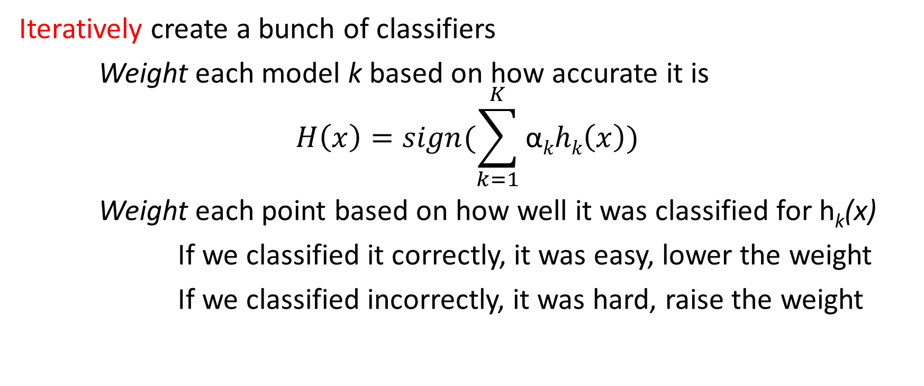
Boosting – Favoring Certain Points
Iteratively create a bunch of classifiers
Weight each model k based on how accurate it is
$$H\left(x\right)=sign(\sum_{k=1}^{K}{\text{α}khk\left(x\right)})$$
Weight each point based on how well it was classified for h_{k}(x)
If we classified it correctly, it was easy, lower the weight
If we classified incorrectly, it was hard, raise the weight

Slide 107
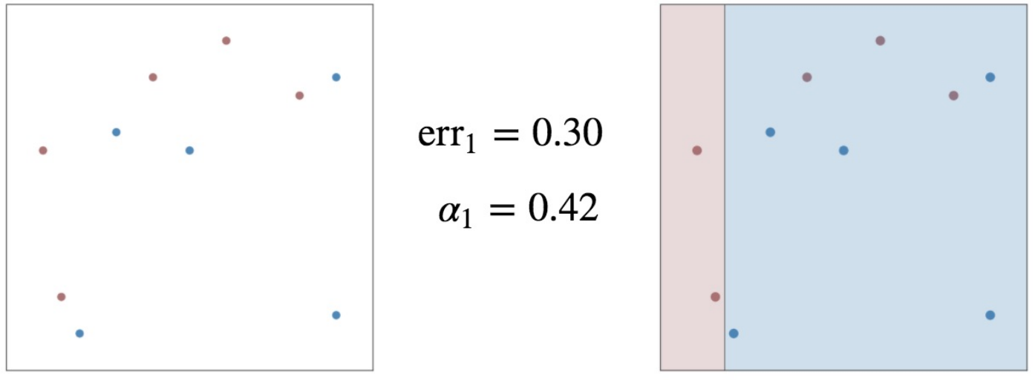
Boosting – Favoring certain Points

Slide 108
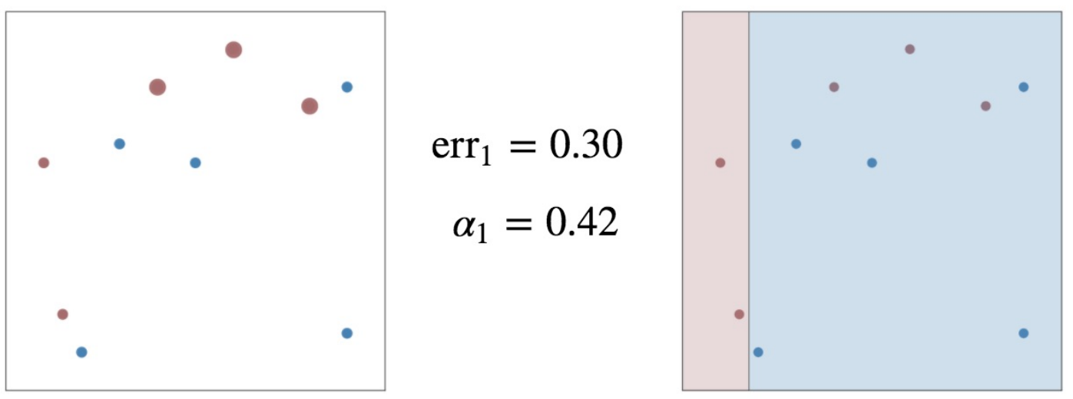
Boosting – Favoring certain Points

Slide 109
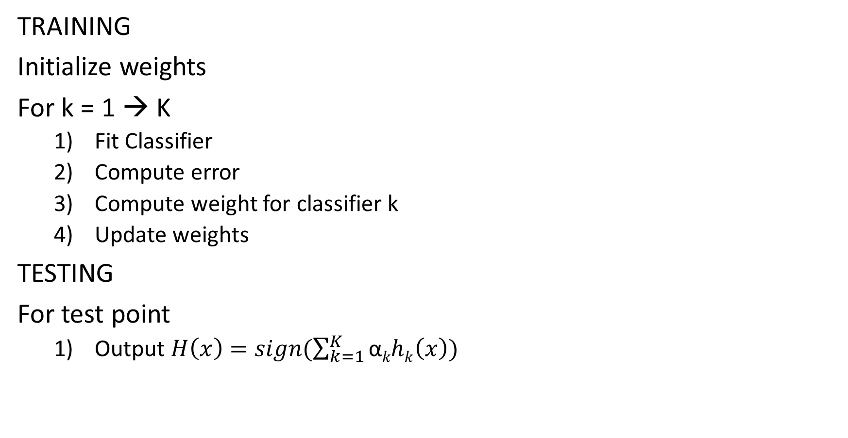
Adaboost in practice
TRAINING
Initialize weights
For k = 1 → K
Fit Classifier
Compute error
Compute weight for classifier k
Update weights
TESTING
For test point
Output $H\left(x\right)=sign(\sum_{k=1}^{K}{\text{α}khk\left(x\right)})$

Slide 110
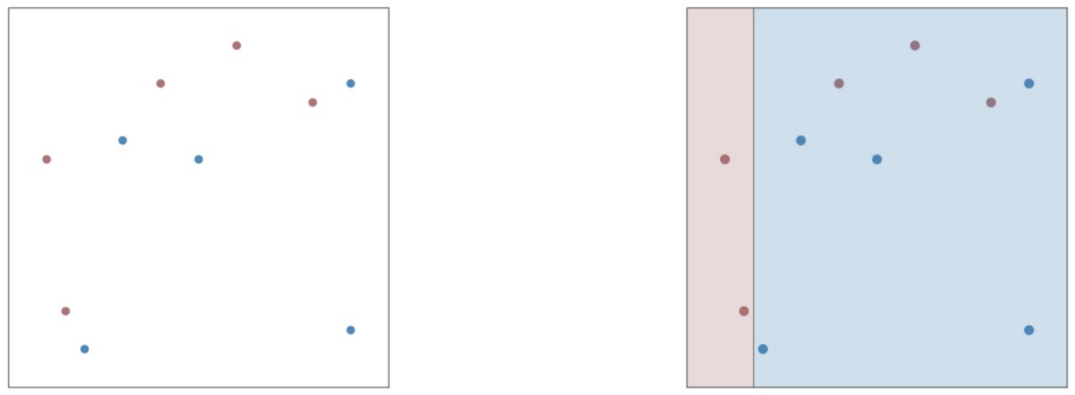
Adaboost – Working Example
First Decision Stump

Slide 111
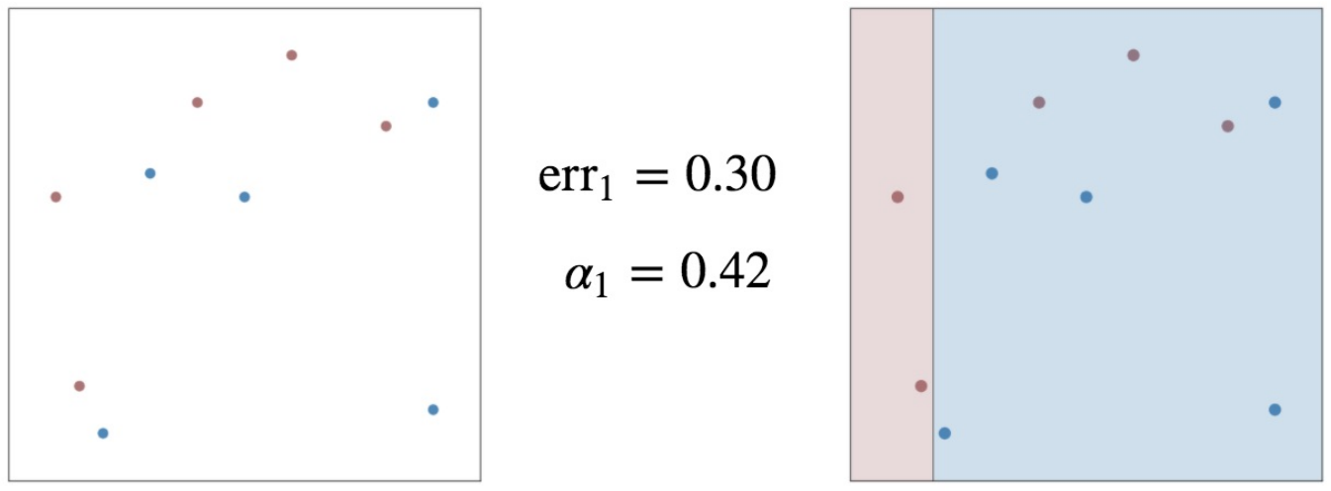
Adaboost – Working Example
First Decision Stump

Slide 112
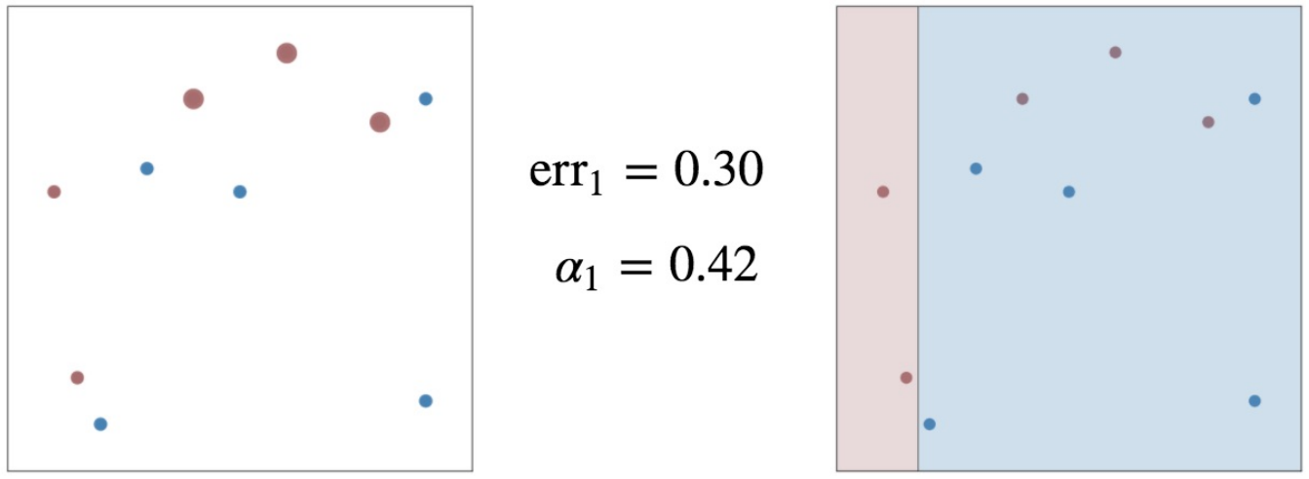
Adaboost – Working Example
First Decision Stump

Slide 113
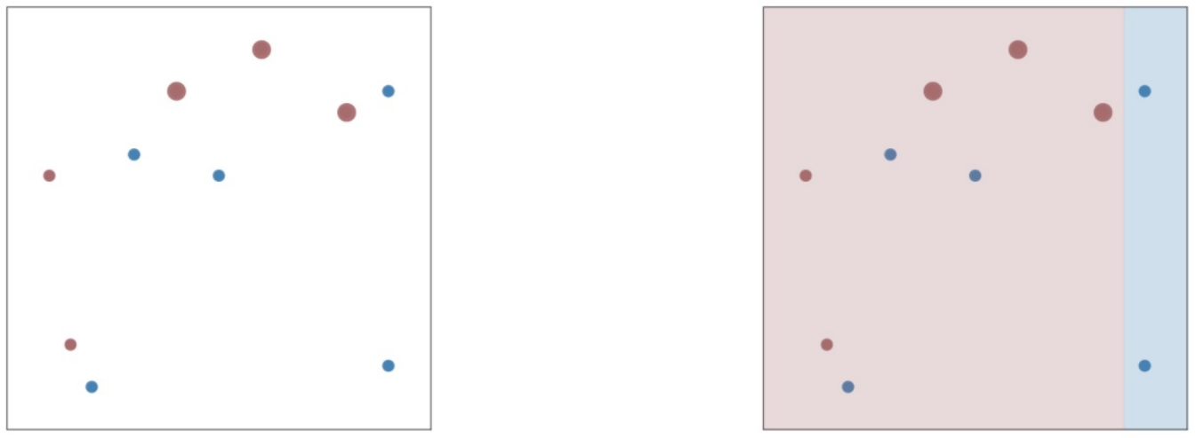
Adaboost – Working Example
Second Decision Stump

Slide 114
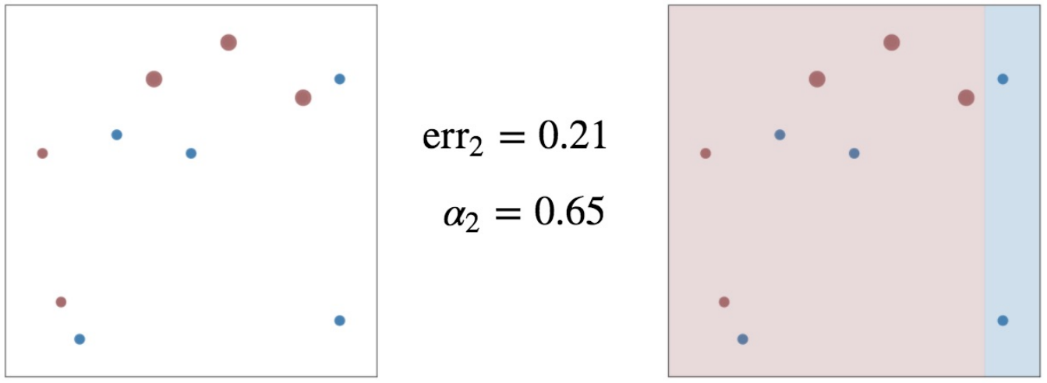
Adaboost – Working Example
Second Decision Stump

Slide 115
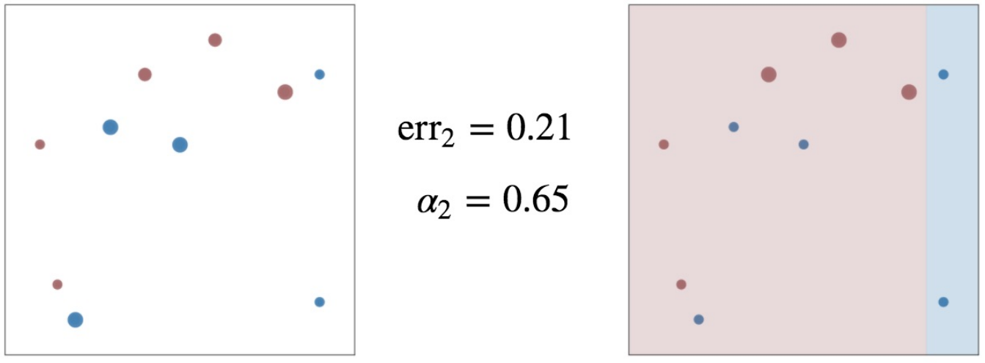
Adaboost – Working Example
Second Decision Stump

Slide 116
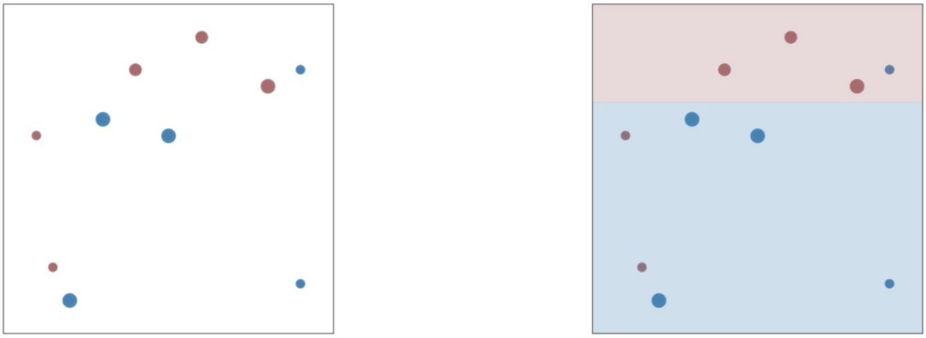
Adaboost – Working Example
Third Decision Stump

Slide 117
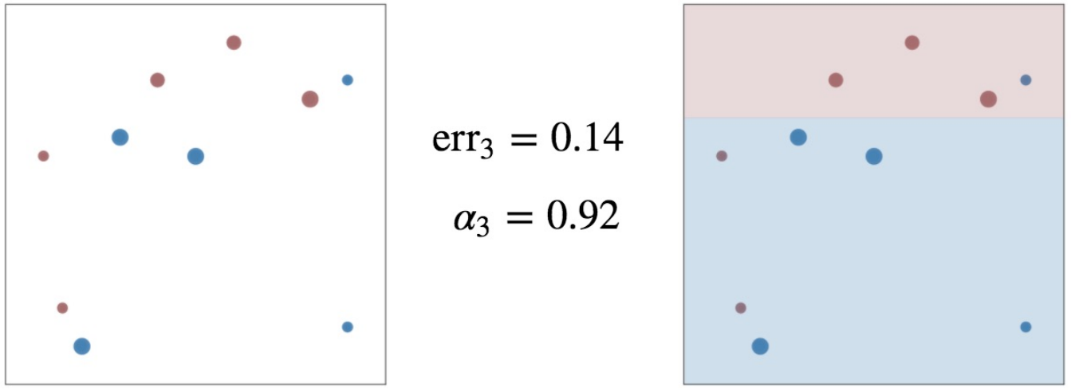
Adaboost – Working Example
Third Decision Stump

Slide 118
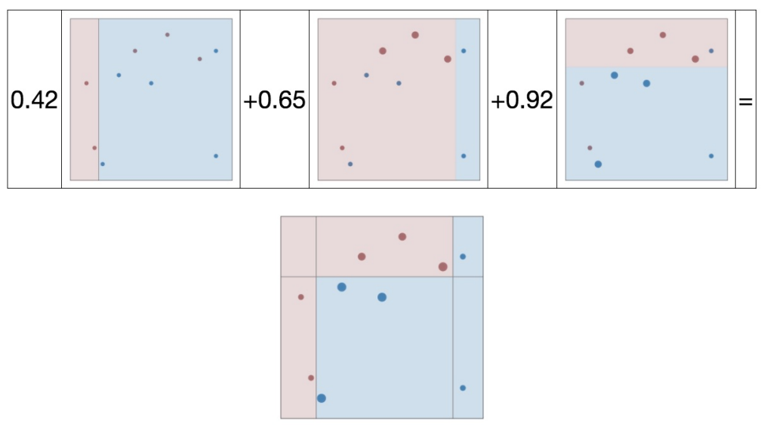
Adaboost – Working Example
Final Ensemble Model

Slide 119
Boosting - Benefits
Reducing the variance?
Variance – Sensitivity to the training set
Reducing the bias?
Bias – Sensitivity to the model

Slide 120
Boosting - Benefits
Reducing the variance
Variance – Sensitivity to the training set
Yes
Reducing the bias
Bias – Sensitivity to the model
Yes

Slide 121
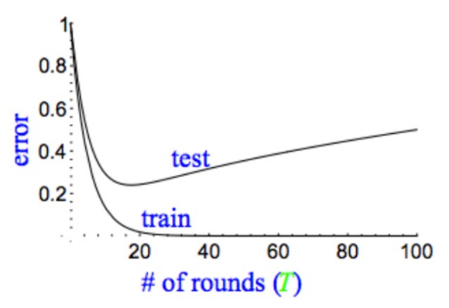
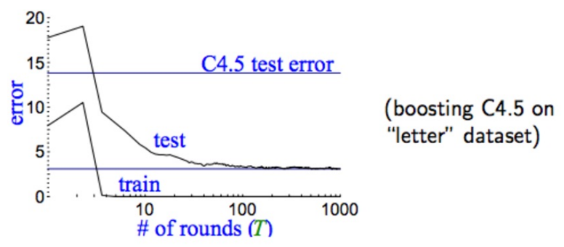
Model Performance
Traditional Models
Boosted Models

Slide 122
Benefits of Boosting
Fast
Easy to Train
Little tuning (K)
Weak-classifier Independent

Slide 123
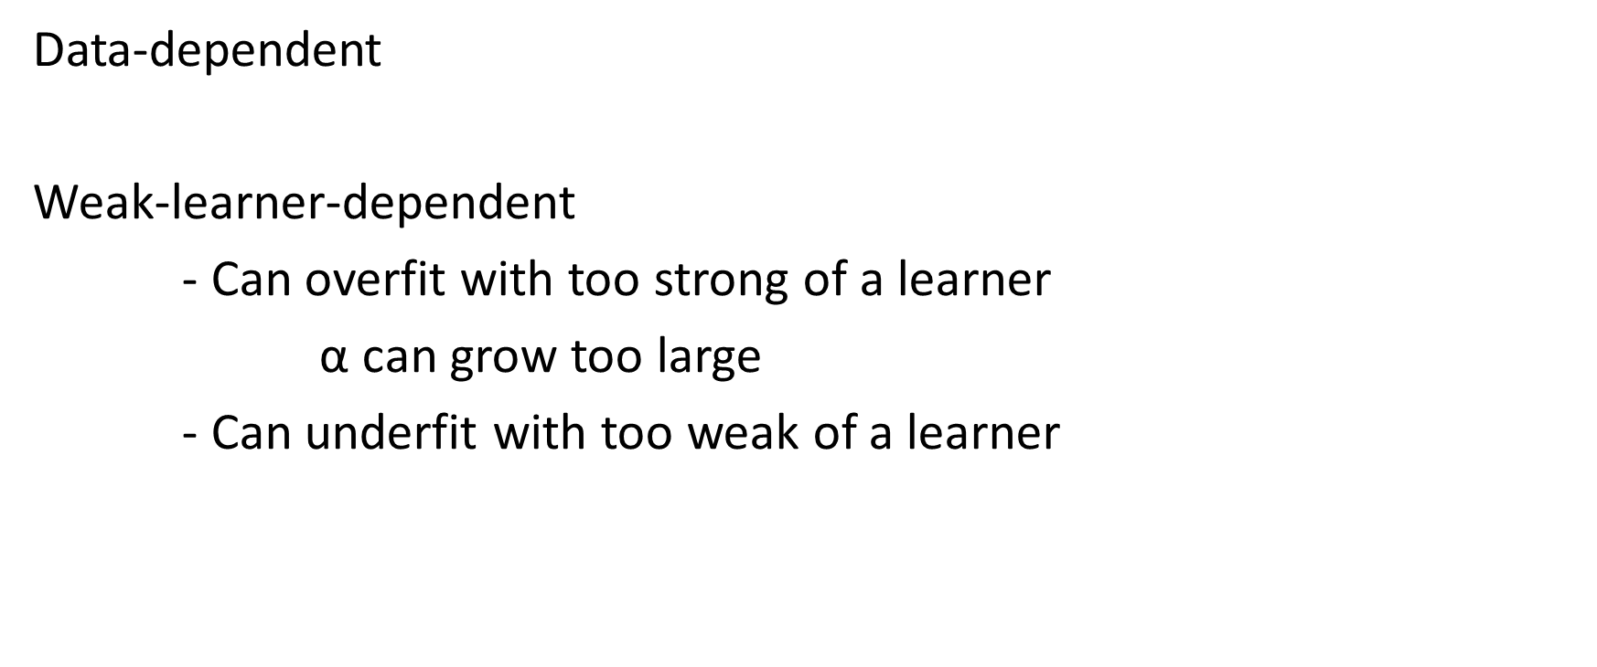
Boosting “gotchas”
Data-dependent
Weak-learner-dependent
- Can overfit with too strong of a learner
$\text{α}$ can grow too large
- Can underfit with too weak of a learner

Slide 124
Exercise 3 – Decision Trees & Forests
Classifying our Adult Dataset

Slide 125
Deciding More Complex Things

Slide 126
Binary Classification
Classified As Ground Truth | Cancer | Not Cancer
Cancer | True Positive (Hit) | False Negative (Miss)
Not Cancer | False Positive (False Alarm) | True Negative (Correct Rejection)

Slide 127
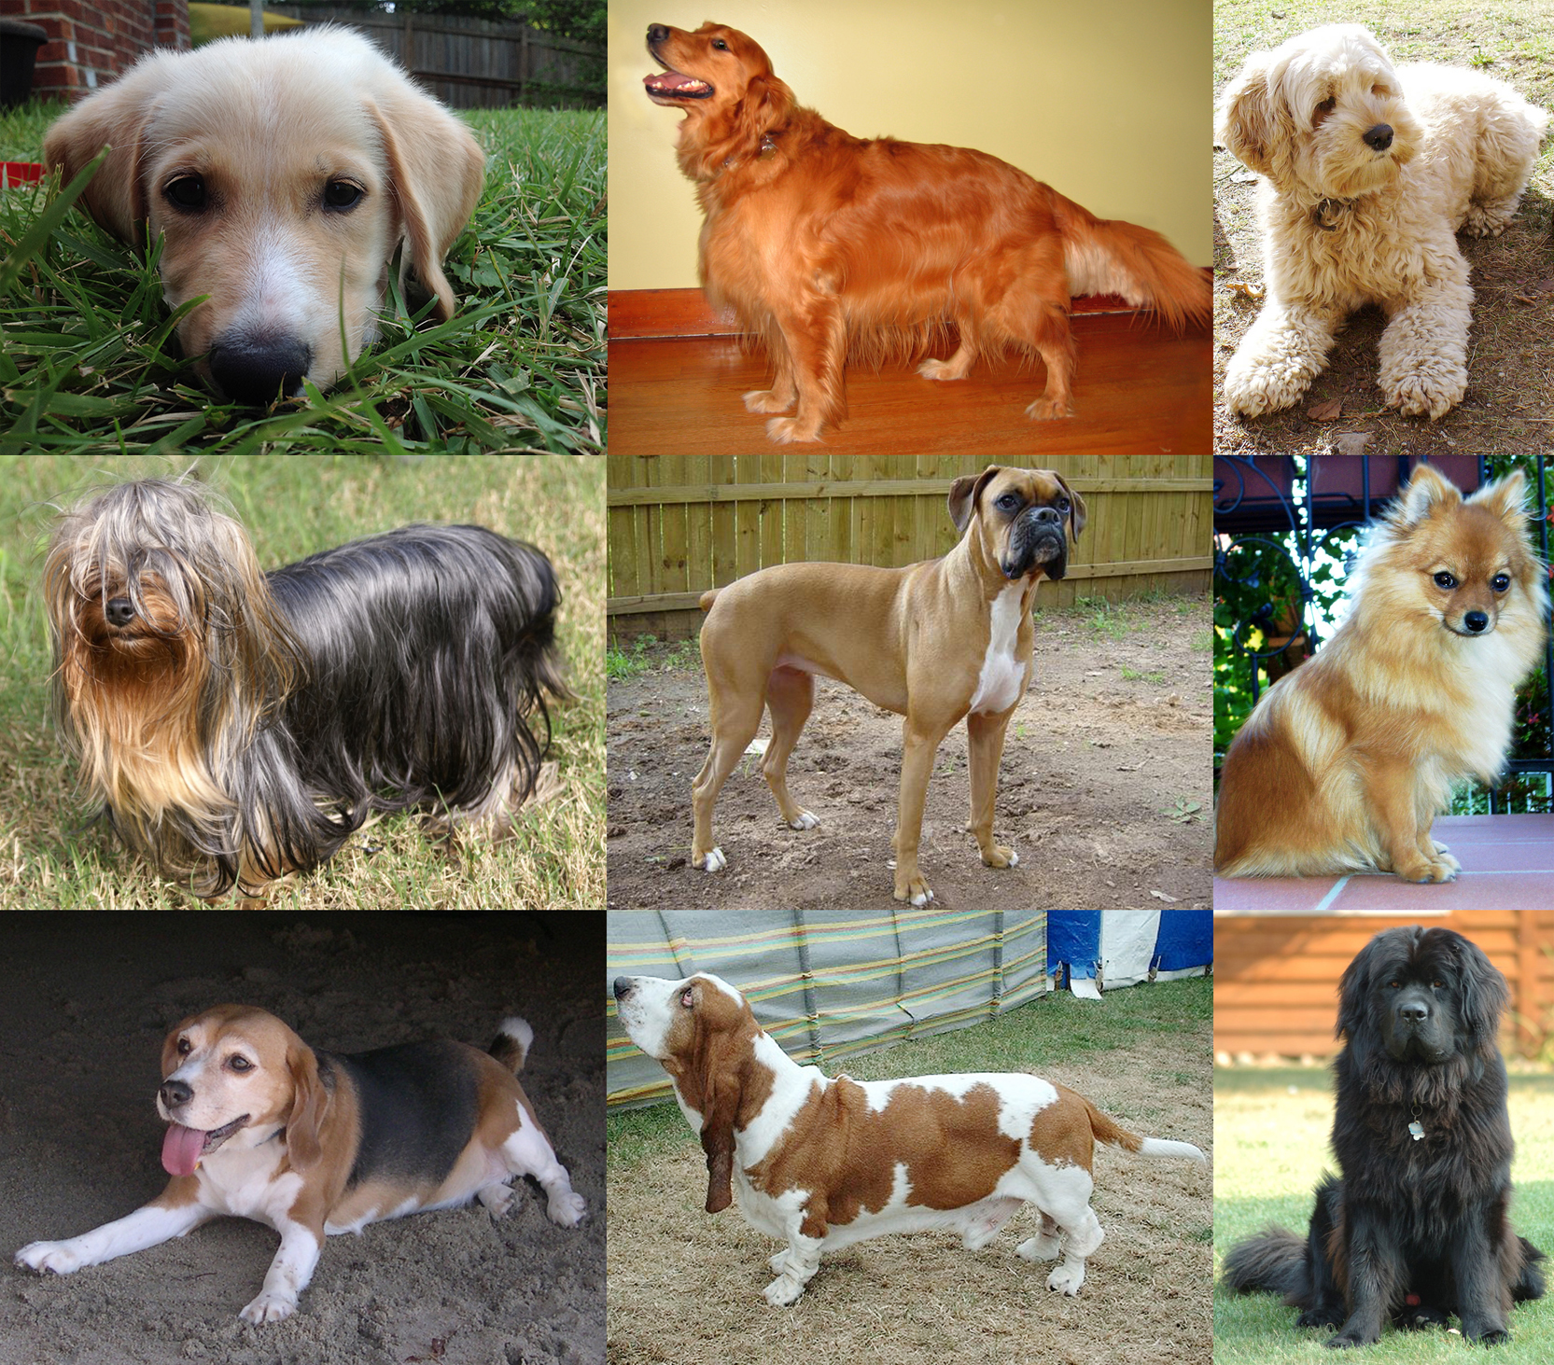
Multi-Class Example
Notes:
https://upload.wikimedia.org/wikipedia/commons/d/d9/Collage_of_Nine_Dogs.jpg

Slide 128
Multi-Class Example - Dogs
Height | Weight | Color | Dog Type
22 in | 62 lbs | Black | Black Lab
15 in | 45 lbs | White, brown | English Bulldog
9 in | 19 lbs | Black | Dachshund

Slide 129
Classification → Binary Classification
Is this tweet positive Is this tweet positive or not positive?
or negative?
Y = {pos, neg} Y = {1, 0}
y = argmax_{c} p(c|x, D) p(y=0 | x, D) = 1 – p(y=1 | x, D)

Slide 130
Classification vs. Binary Classification
Y = {1, 2, 3, …, n} Y = {1, 0}
y = argmax_{c} p(c|x, D) p(y=0 | x, D) = 1 – p(y=1 | x, D)
Determining the decade Positive or not positive tweets
of birth
Species of tree Is the road clear of obstructions?
Type of road sign

Slide 131
Classification vs. Binary Classification
Some methods are inherently capable of multi-class classification
Naïve Bayes - y = argmax_{c} p(c|x, D)
KNN – find N_{k}(x, D), assign the majority (plurality) label to x

Slide 132
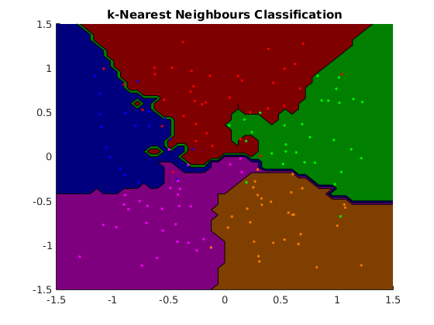
Multi-Class Classification - KNN
Notes:
https://www.cs.ubc.ca/~schmidtm/Software/matLearn/multiclass/demos/html/demo_multiclass_KNN_01.png

Slide 133
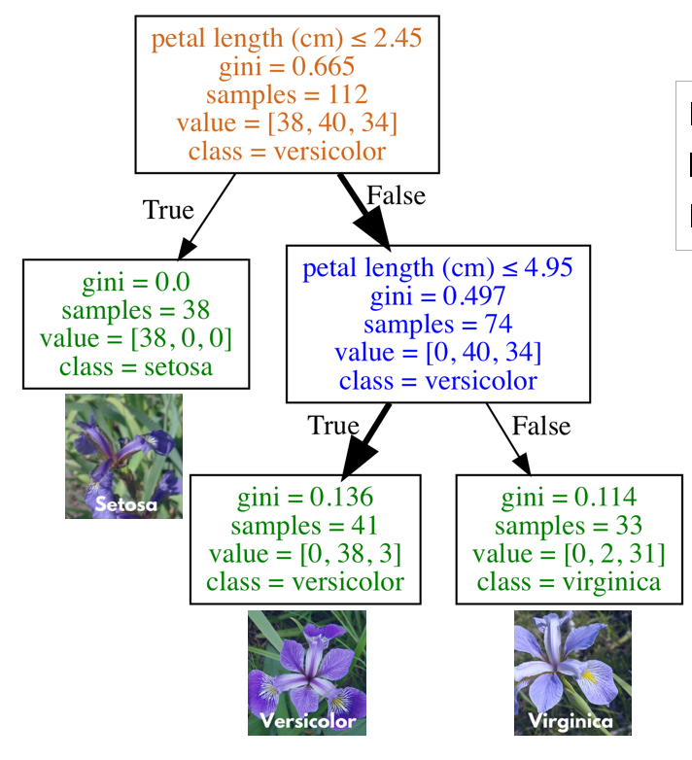
Multi-Class Classification – Decision Trees

Slide 134
Interlude – Types of Data
Continuous Numeric
- Maps to a “real” number
- Distances between numbers have meaning
Discrete Numeric
- Maps to a discrete, infinite set (e.g. integers)
- Distances between numbers have meaning
Ordinal
- Entries have an order, but distances lose meaning
Categorical
- Entries are each unique, but don’t have further restrictions

Slide 135
“Classify” a Numeric Problem?
…

Slide 136
It’s not Classification, it’s Regression!

Slide 137
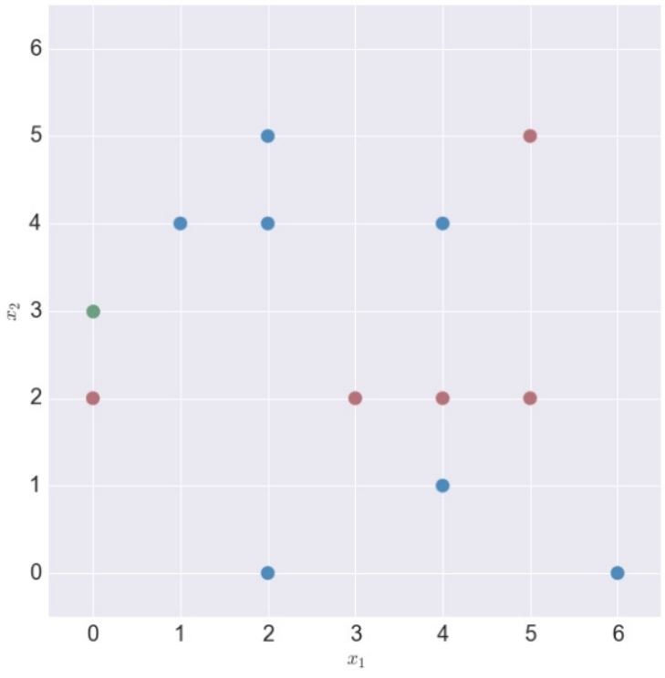
Regression – K-Nearest Neighbors
Our Y values are now Numeric

Slide 138
Regression – K-Nearest Neighbors
Our Y values are now Numeric

Slide 139
Regression – K-Nearest Neighbors
Our Y values are now Numeric
Step 1) Find your nearest neighbors
Step 2) Compute the mean

Slide 140
Regression – Decision Trees

Slide 141
Exercise 4 – Regression (A)
Housing Prices in California
Regression Tree
Regression Forest

Slide 142
What’s the Outcome?
In Classification, it was the “accuracy” (1 – error)

Slide 143
What’s the Outcome?
In Classification, it was the “accuracy” (1 – error)
I really doubt that ~60% of our predicted values were exactly correct with the Tree, and ~80% with the forest…

Slide 144
What’s the Outcome?
In Classification, it was the “accuracy” (1 – error)
I really doubt that ~60% of our predicted values were exactly correct with the Tree, and ~80% with the forest…
What we’re getting is an R² value – the “coefficient of determination”
How much of the variance in the dependent variable can be predicted / explained by our model of the independent variables?

Slide 145
What’s the Outcome?
In Classification, it was the “accuracy” (1 – error)
I really doubt that ~60% of our predicted values were exactly correct with the Tree, and ~80% with the forest…
What we’re getting is an R² value – the “coefficient of determination”
How much of the variance in the dependent variable can be predicted / explained by our model of the independent variables?
So what’s a “good” R² score?
It depends!

